Slide 1
Lego sorting

Slide 2
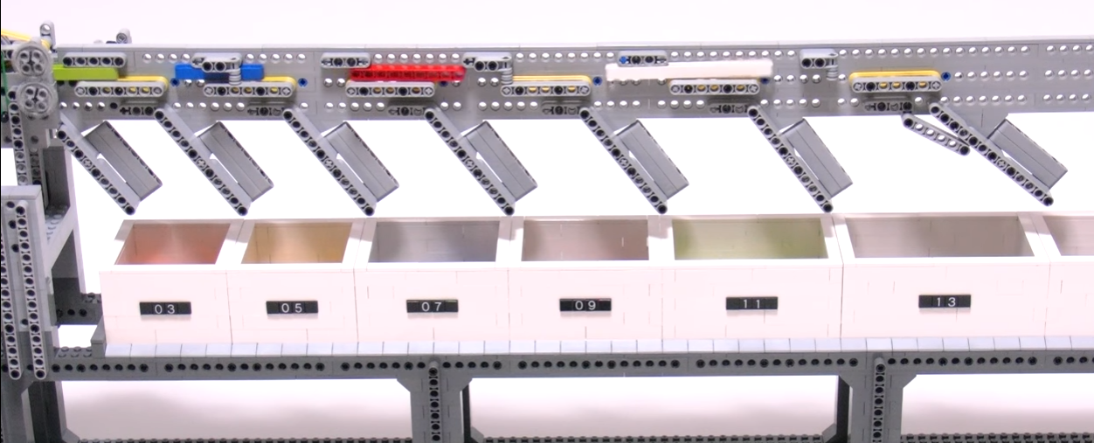
Mechanical sorting
https://www.youtube.com/watch?v=nlCSlJuD65A

Slide 3
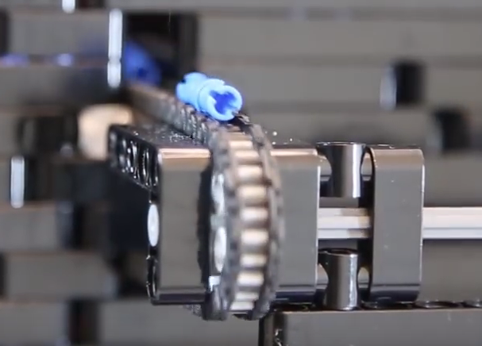
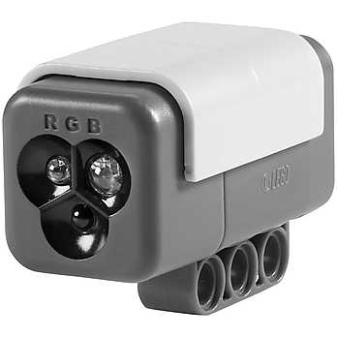
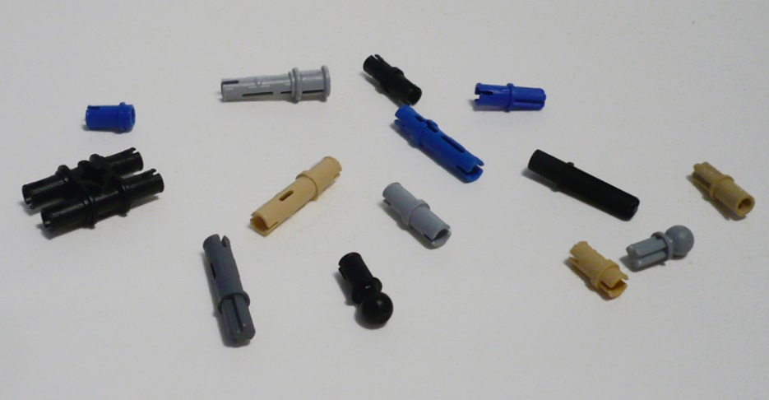
Sensor input
https://www.youtube.com/watch?v=CuW73P5PanM

Slide 4
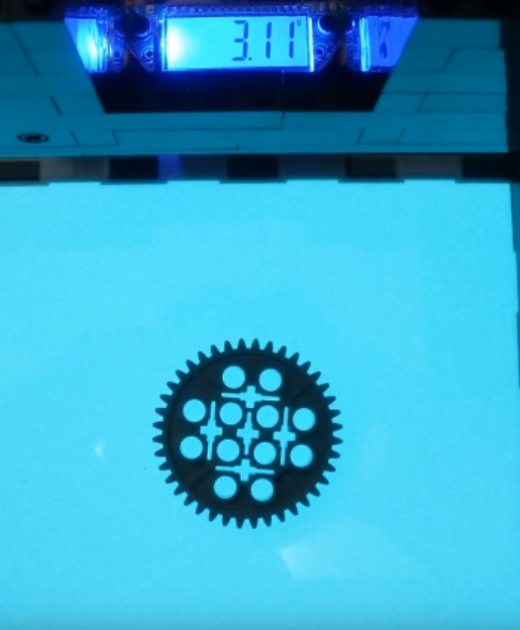
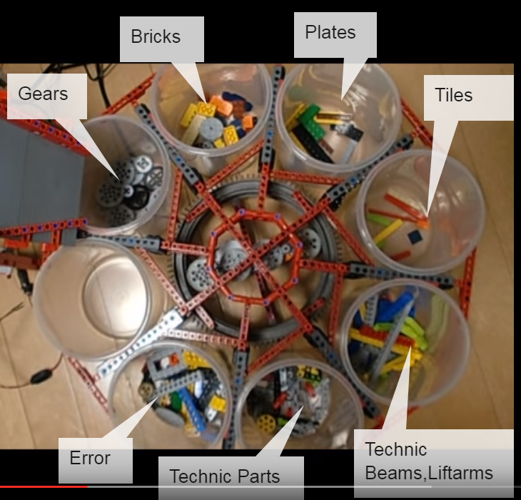
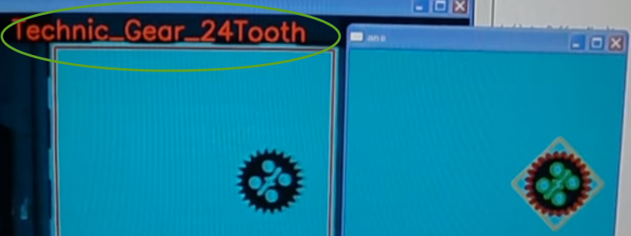
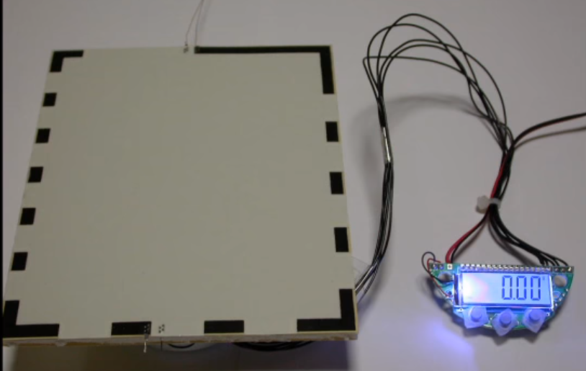
Smart/AI sorting
https://www.youtube.com/watch?v=6lZ9rSZwDzE

Slide 5
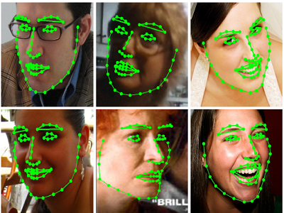
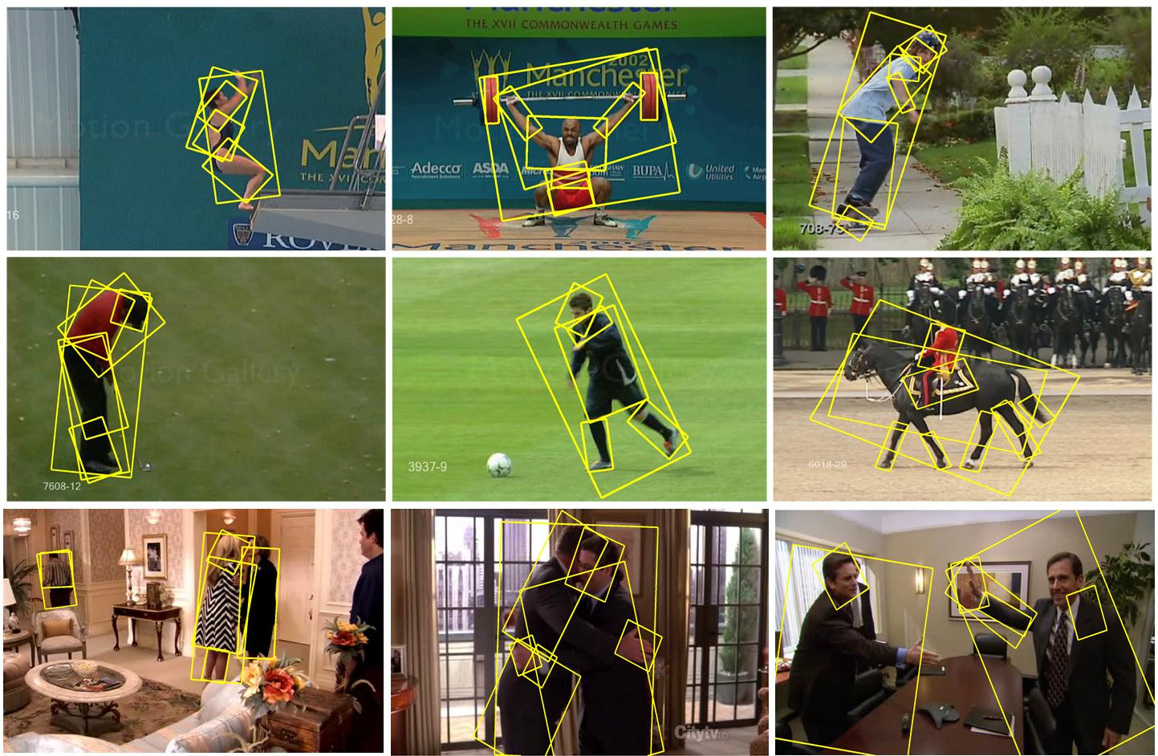
Computer image recognition techniques

Slide 6
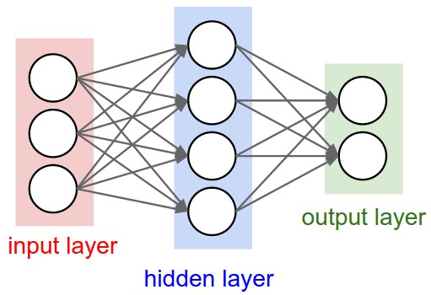

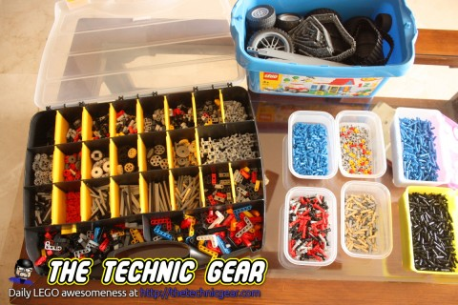
Neural networks
The art of neural networks https://www.youtube.com/watch?v=0qVOUD76JOg

